Slide 1

`
Malaria Detection using CNN and Transfer Learning
Presenter: Ashish Kumar
Student ID: 108998404
Instructor: Prof. Kuan-Ting Lai

Slide 2
Outline
Contribution
Introduction
Dataset and Experimental Requirements
Notebook Execution and Results
Conclusion

Slide 3
Contributions
I tried to make a CNN model from scratch and models using Transfer learning for identification of malaria images weather they are parasitic or uninfected.
While poor results were obtained using ResNet50 I achieved an accuracy of approx. 98% with validation accuracy about approx. 85% using VGG19 and achieved an accuracy of 99.44% with validation accuracy about 89.55% using CNN model made from scratch.
Made a sample application using Flask and Spyder IDE.

Slide 4
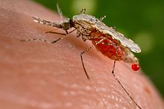
Introduction
Malaria is a mosquito-borne infectious disease that affects humans and other animals.
Malaria causes symptoms that typically include fever, tiredness, vomiting, and headaches.
In severe cases, it can cause yellow skin, seizures, coma, or death.
Symptoms usually begin ten to fifteen days after being bitten by an infected mosquito.
If not properly treated, people may have recurrences of the disease months later.

Slide 5
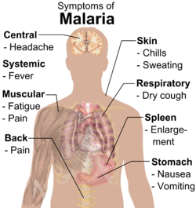
Causes and Symptoms of Malaria
Malaria is caused by Plasmodium parasites.
The parasites are spread to people through the bites of infected female Anopheles mosquitoes, called "malaria vectors."
There are 5 parasite species that cause malaria in humans, and 2 of these species – P. falciparum and P. vivax – pose the greatest threat.

Slide 6
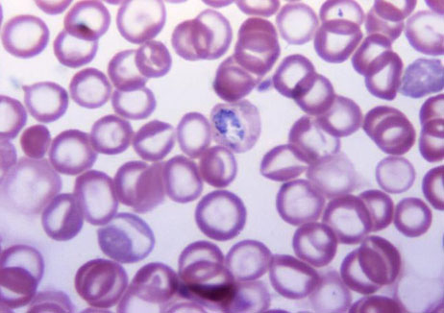
Diagnosis of Malaria
Microscopic Diagnosis
Malaria parasites can be identified by examining under the microscope a drop of the patient’s blood, spread out as a “blood smear” on a microscope slide.
Prior to examination, the specimen is stained to give the parasites a distinctive appearance.
This technique remains the gold standard for laboratory confirmation of malaria.
However, it depends on the quality of the reagents, of the microscope, and on the experience of the laboratorian.

Slide 7
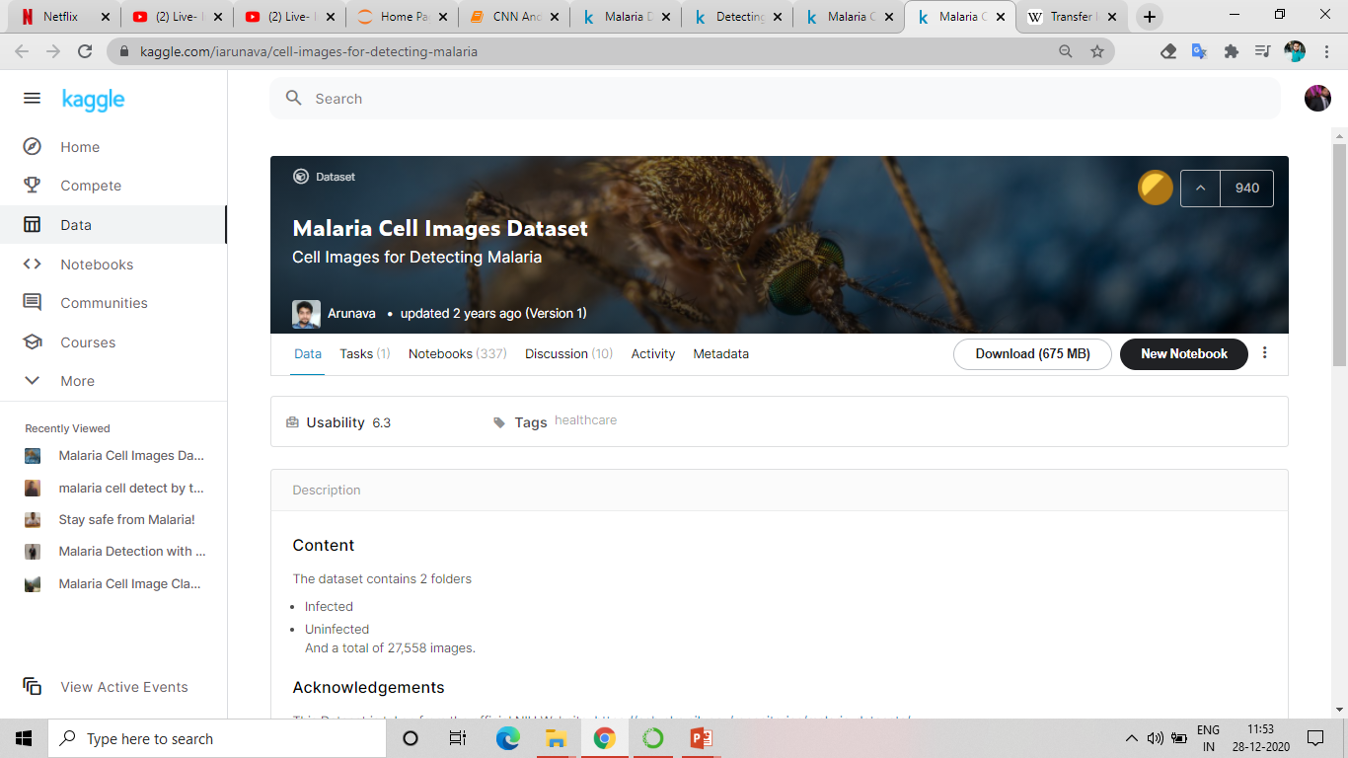
Datasets and Experimental Requirements
“Malaria Cell Images Dataset” from Kaggle was used for this study consisting of images of 139×148 pixels.
Laptop Spec.
Hardware Specifications
System manufacturer | Dell Inc.
System model | Inspiron 3542
System type | x64-based model
Processor | Intel(R) Core(TM) i5-4210U CPU @ 1.70GHz
Installed physical memory (RAM) | 8.00 GB
System memory | More than 512MB
Keyboard | Standard PS/2 Keyboard
Display | Intel(R) HD Graphics Family
Pointing device | Dell touchpad
Software Specifications
OS manufacturer | Microsoft corporation
OS name | Microsoft windows 10
Platform | Colaboratory
Web browser | Chrome/Microsoft edge

Slide 8
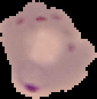
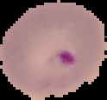
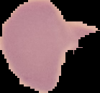
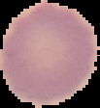
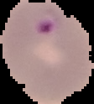
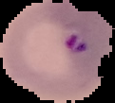

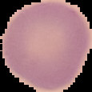
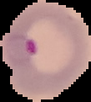
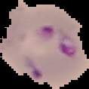
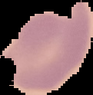
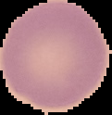
Sample Dataset
Parasite
Uninfected

Slide 9
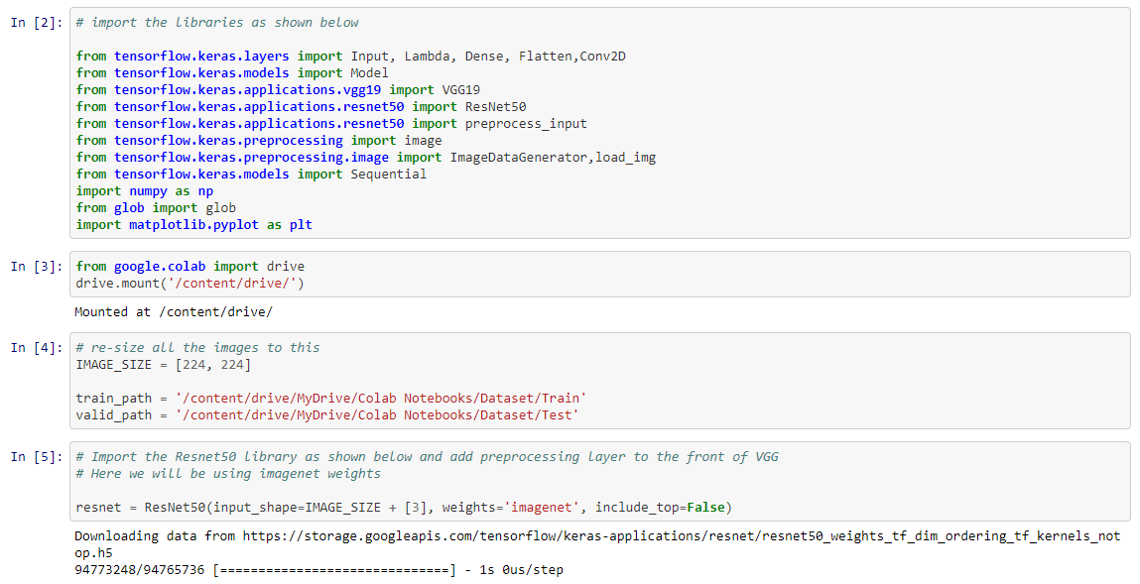
Notebook Execution

Slide 10
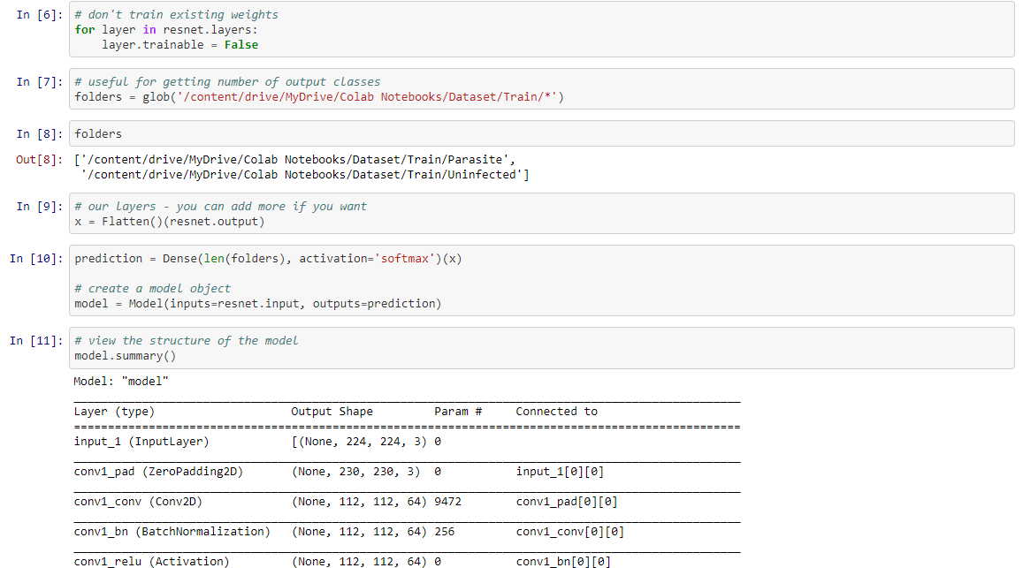
Notebook Execution

Slide 11
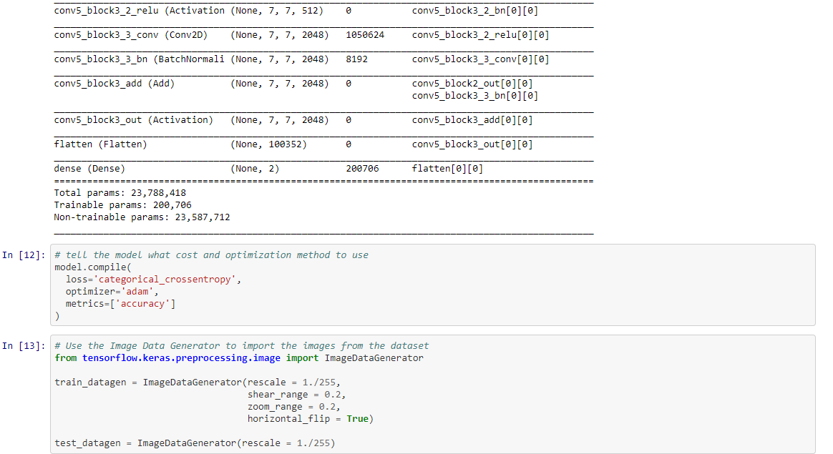
Notebook Execution

Slide 12
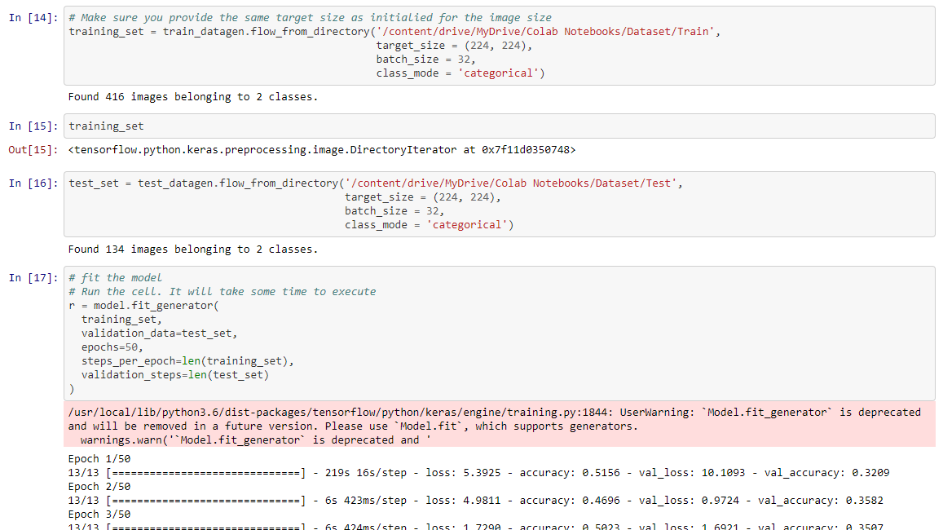
Notebook Execution

Slide 13
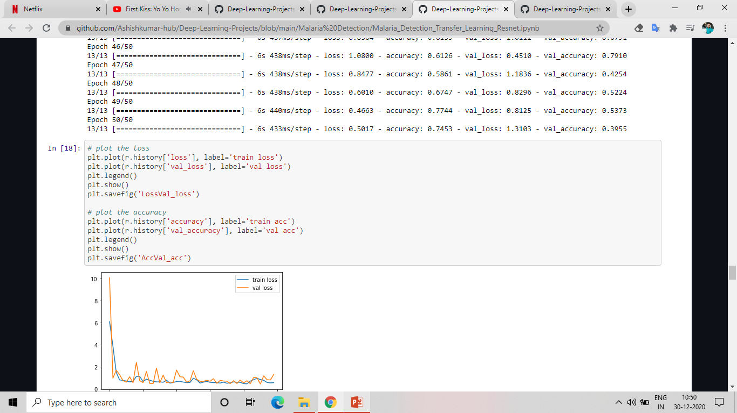
Notebook Execution

Slide 14
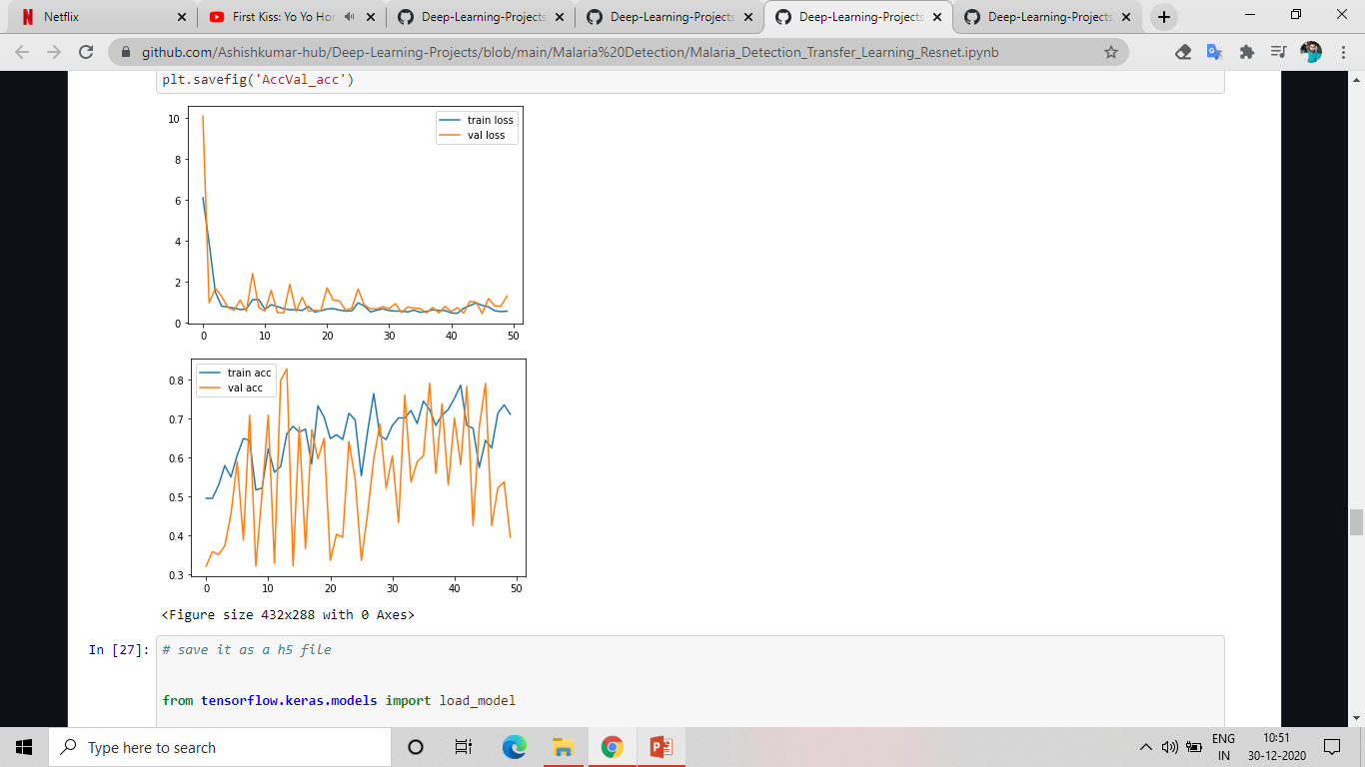
ResNet50 Results
LOSS
ACCURACY

Slide 15
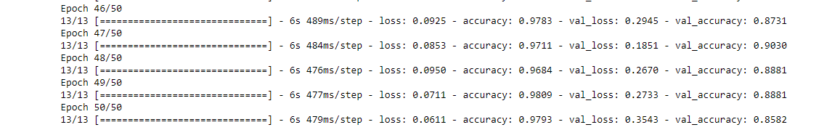
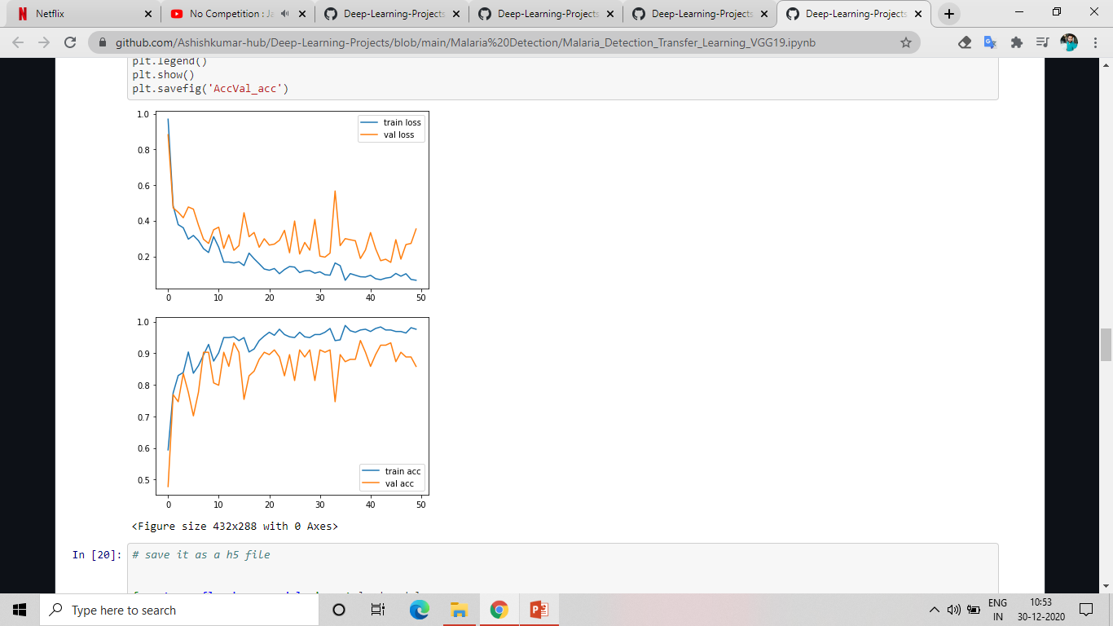
VGG19 Results
LOSS
ACCURACY

Slide 16
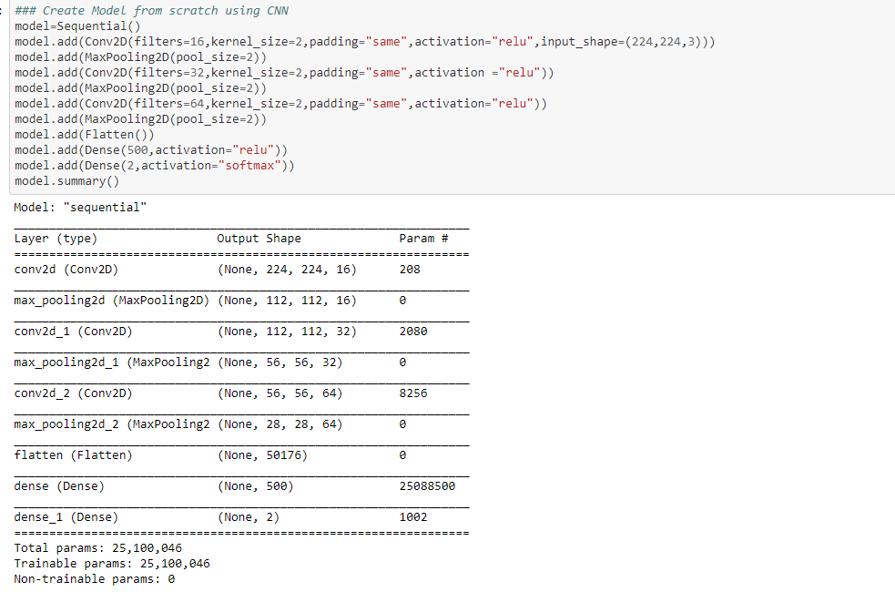
CNN Model Results

Slide 17
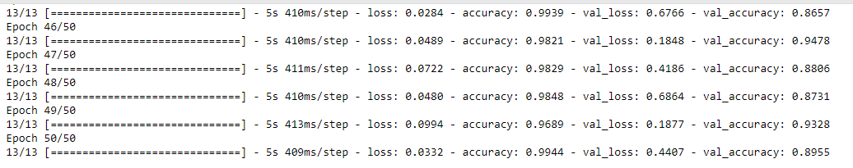
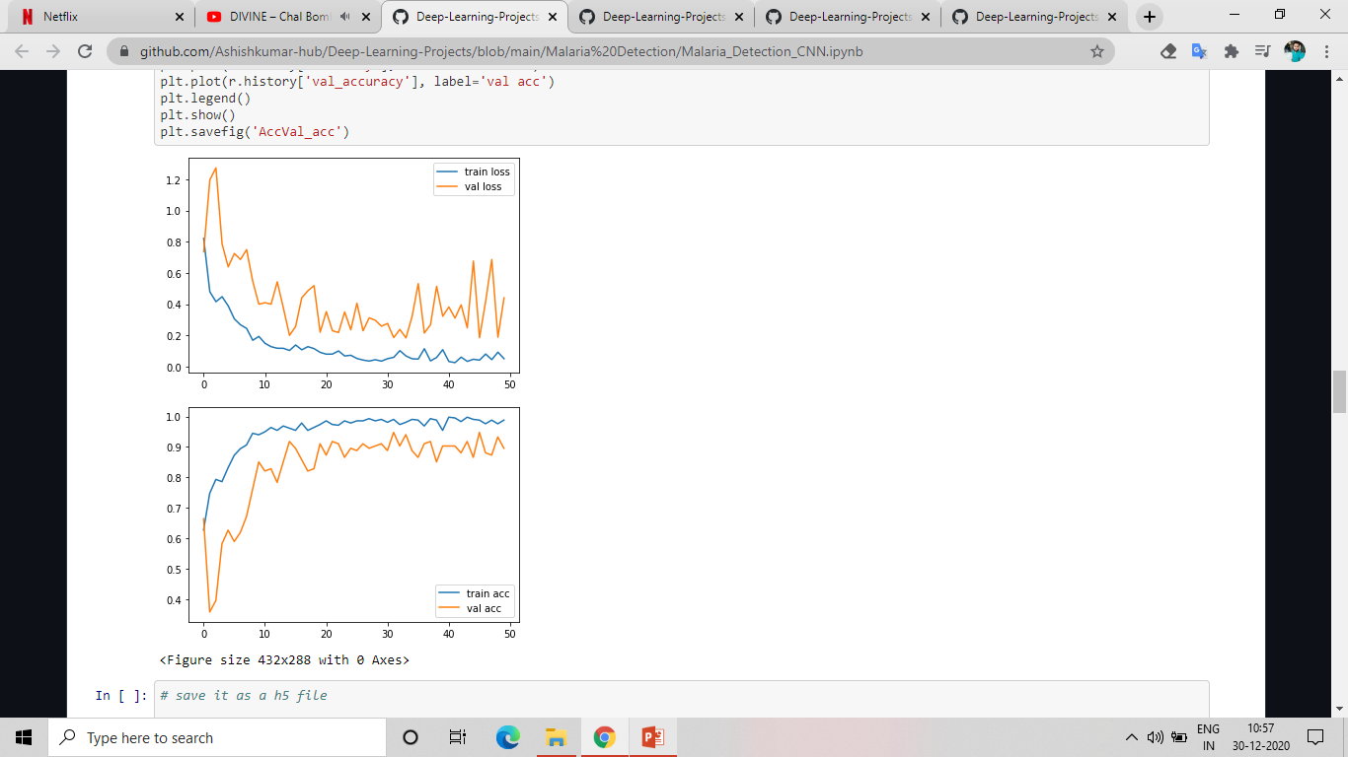
CNN Model Results
LOSS
ACCURACY

Slide 18
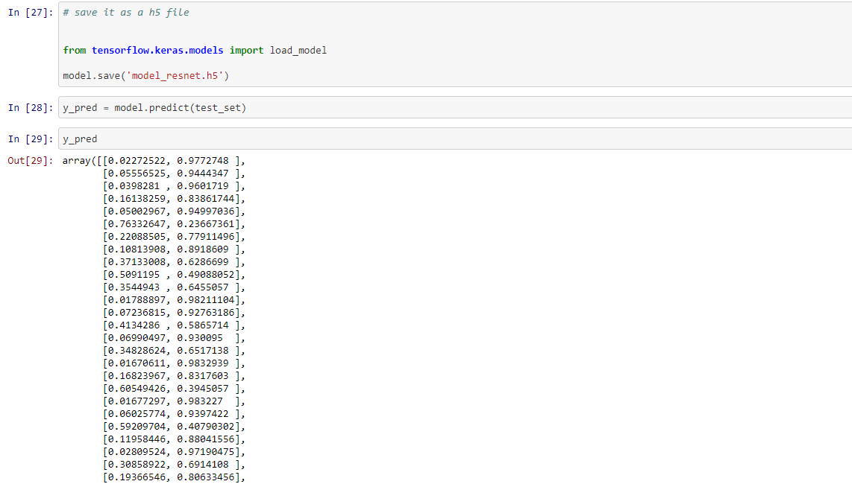
Notebook Execution

Slide 19
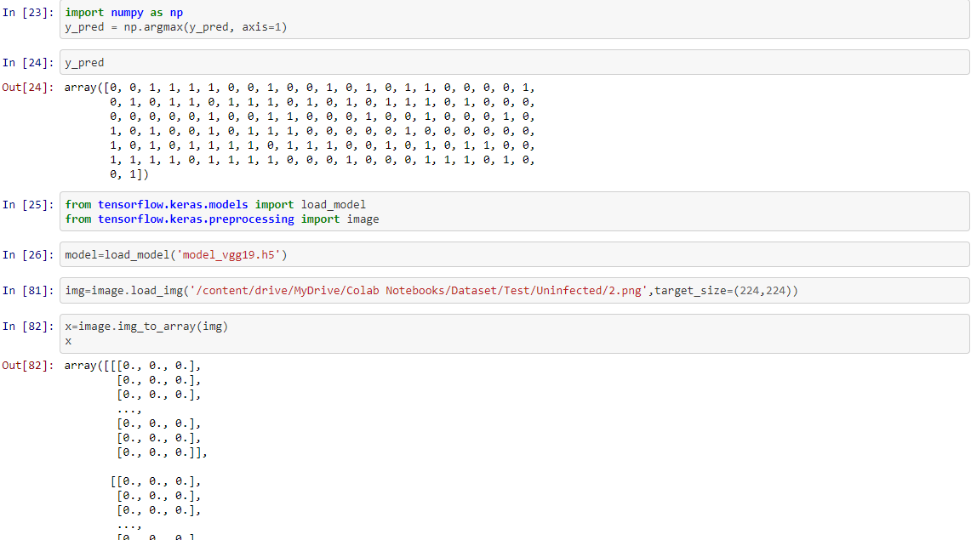
Notebook Execution: VGG19 Model

Slide 20
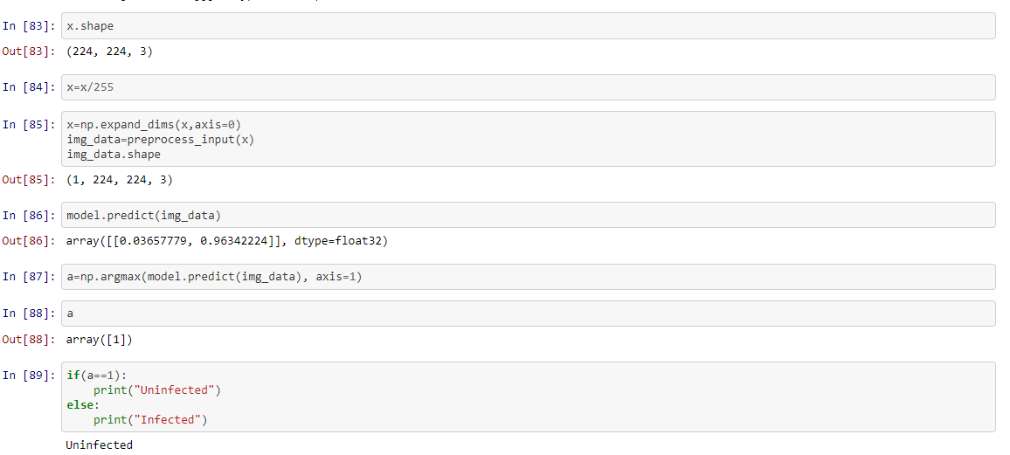
Notebook Execution

Slide 21
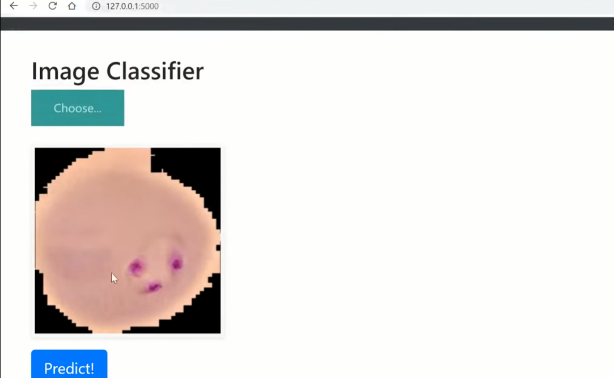
Model Deployment: Application Using Flask and Spyder IDE
Image Classifier
Click on chose to pick a image from local storage.
Click on Predict to see whether the image is “Parasitic” or “Uninfected”.

Slide 22

Conclusions
Created a CNN model from scratch which gives better accuracy than other models for identification of malaria images whether they are parasitic or unidentified.
The experimental results show that the proposed model demonstrates much higher accuracy then other models.
Achieved an accuracy of approx. 98% with validation accuracy about approx. 85% using VGG19 and achieved an accuracy of 99.44% with validation accuracy about 89.55% using CNN model made from scratch.
Sample application was made using Flask and Spyder IDE.
Code is available at: https://github.com/Ashishkumar-hub/Deep-Learning-Projects/tree/main/Malaria%20Detection

Slide 23
Thank You!

